Slide 1
My Discord Game Bot
Chung Ting Lee 12/06/21

Slide 2
How this bot work?
Type !BJ to active this bot.
When you push the thumbs up button, it will automatically roll A-K.
If you want to stop, you just need to push the thumbs down button.

Slide 3
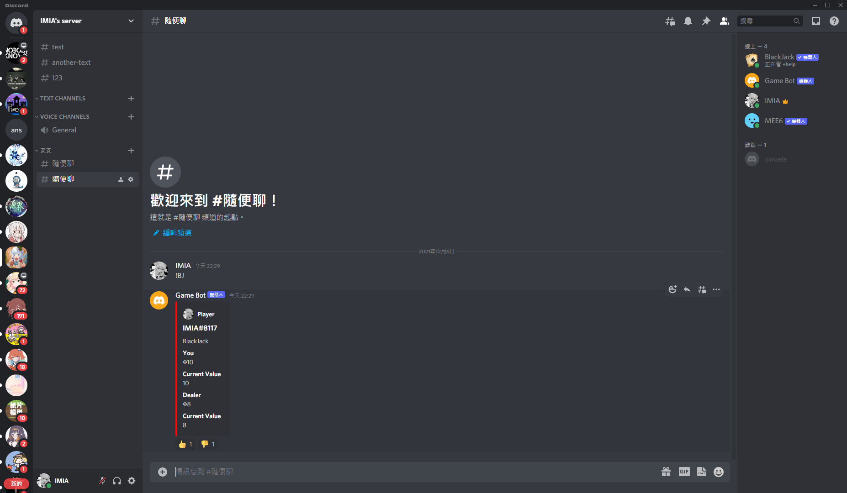
User type in !BJ to active BOT

Slide 4
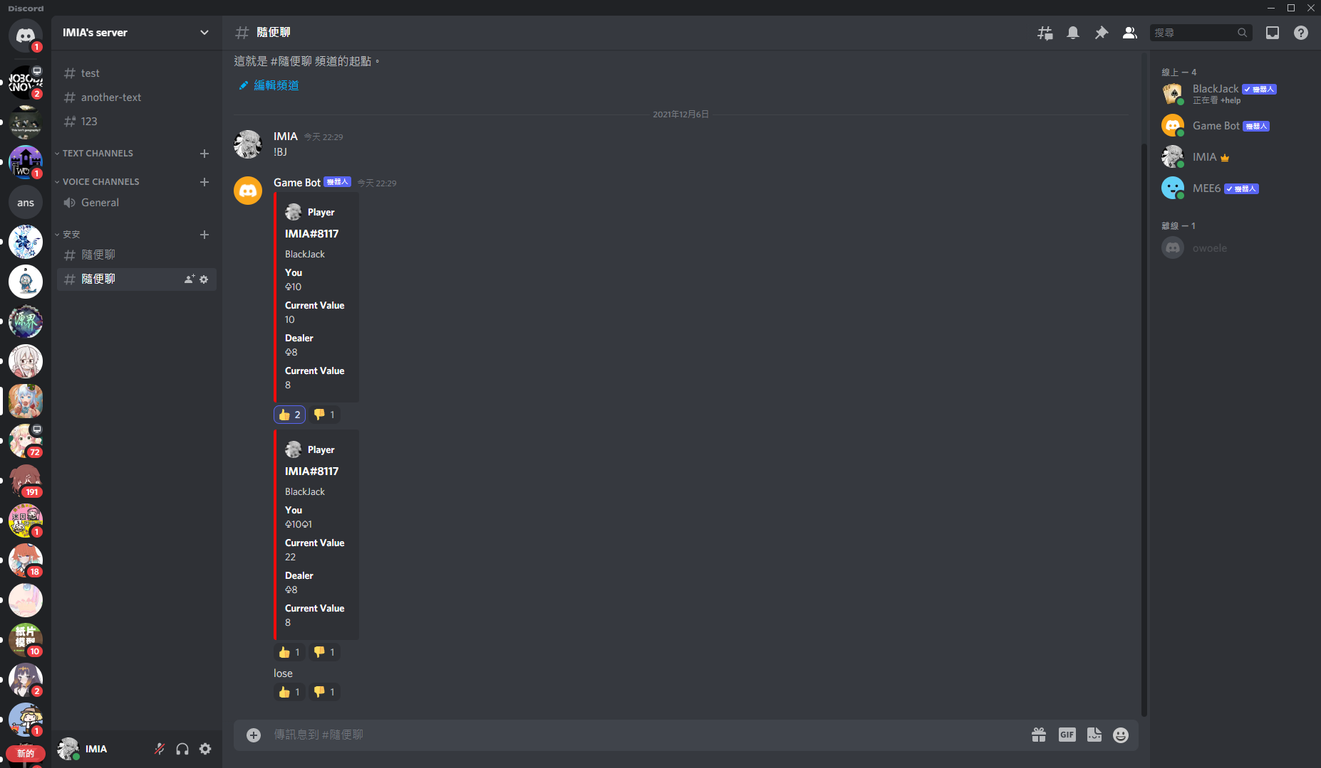
User push button to draw a card

Slide 5
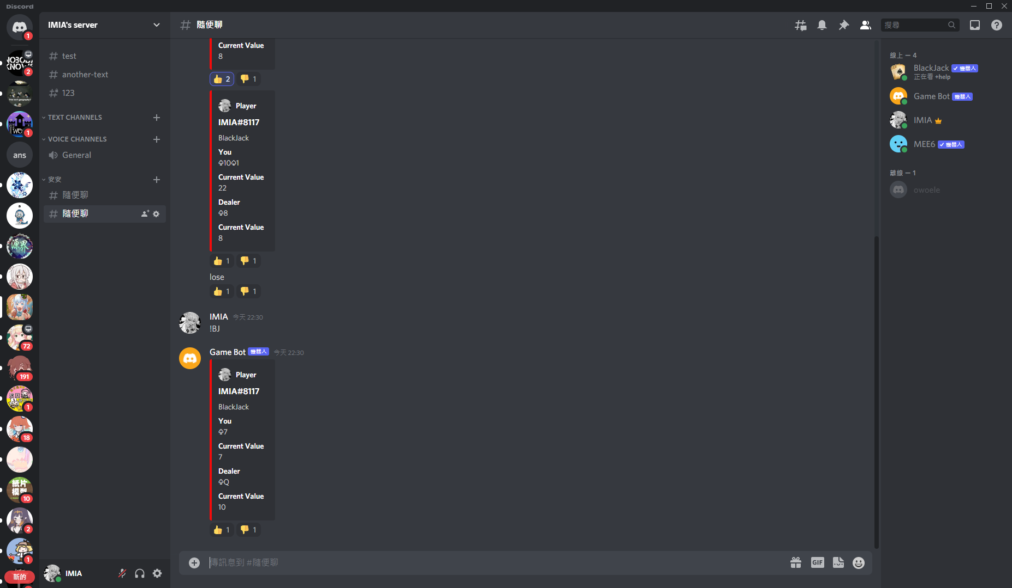
User lose, and BOT will send ‘lose’ in channel

Slide 6
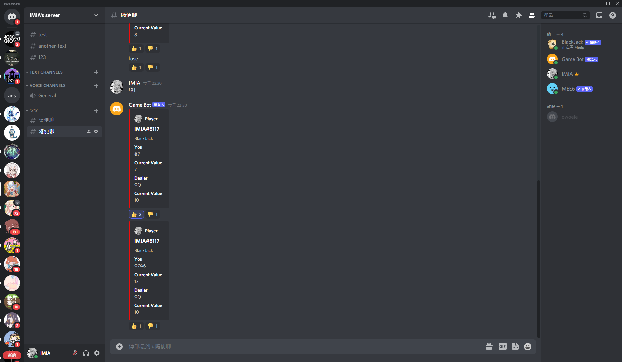
User type in !BJ to active BOT again

Slide 7
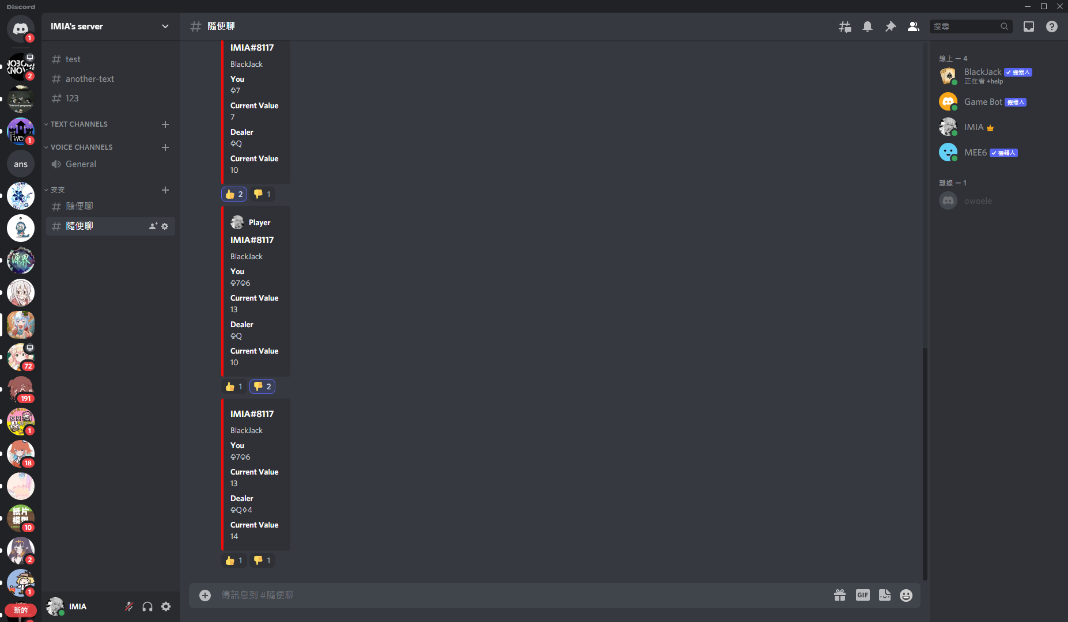
This time change to draw cards for dealer.
P.S. I was trying to use while loop, but it didn’t work. That is why user need to push by themselves.

Slide 8
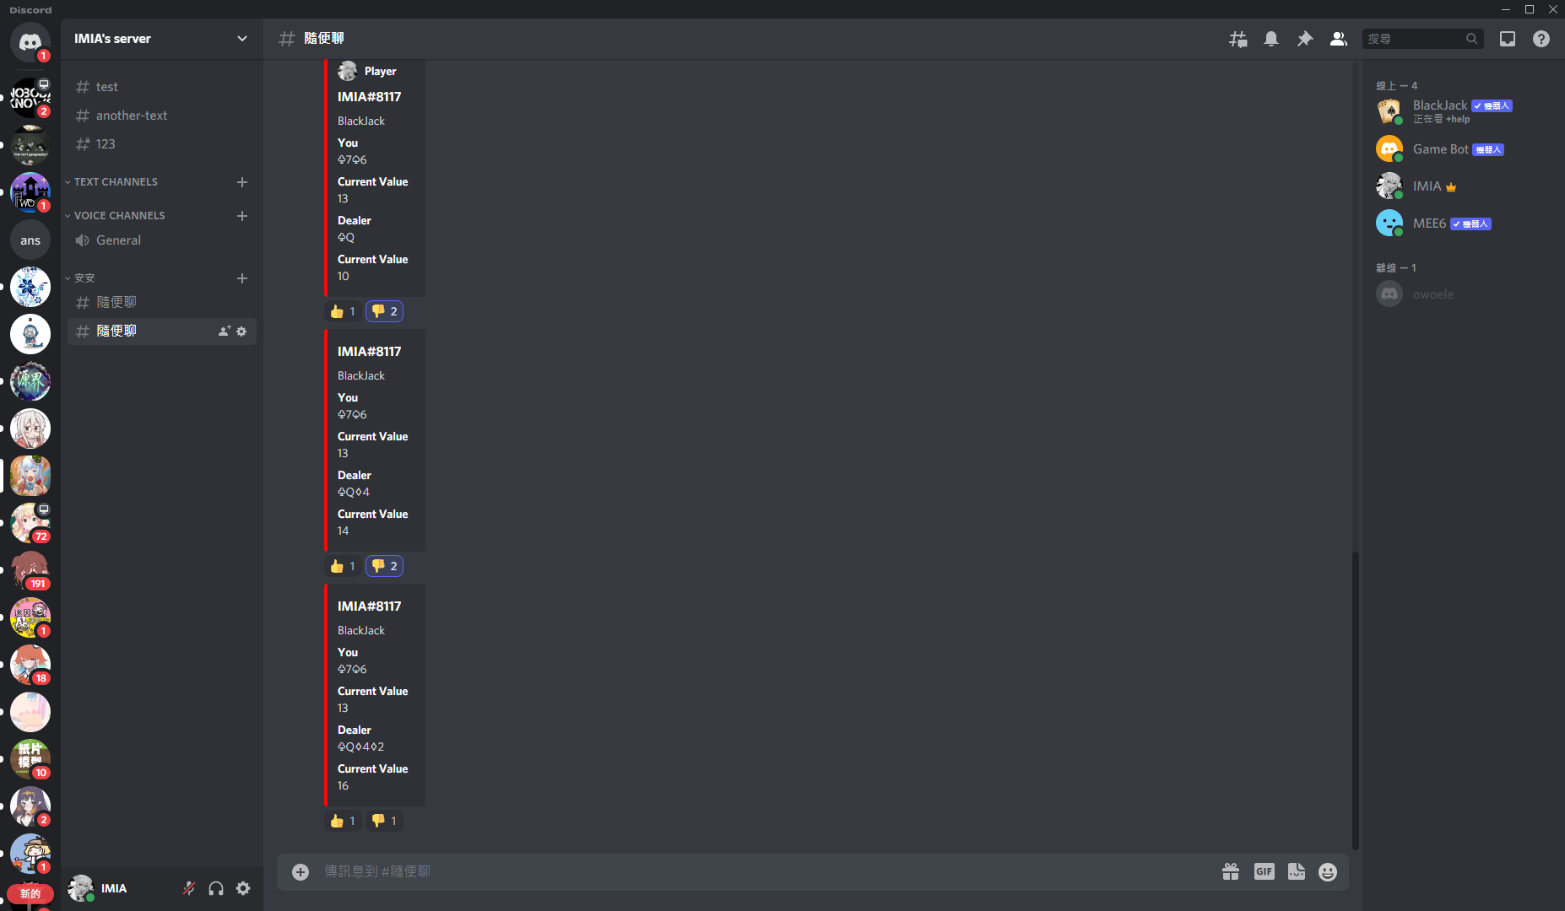

Slide 9
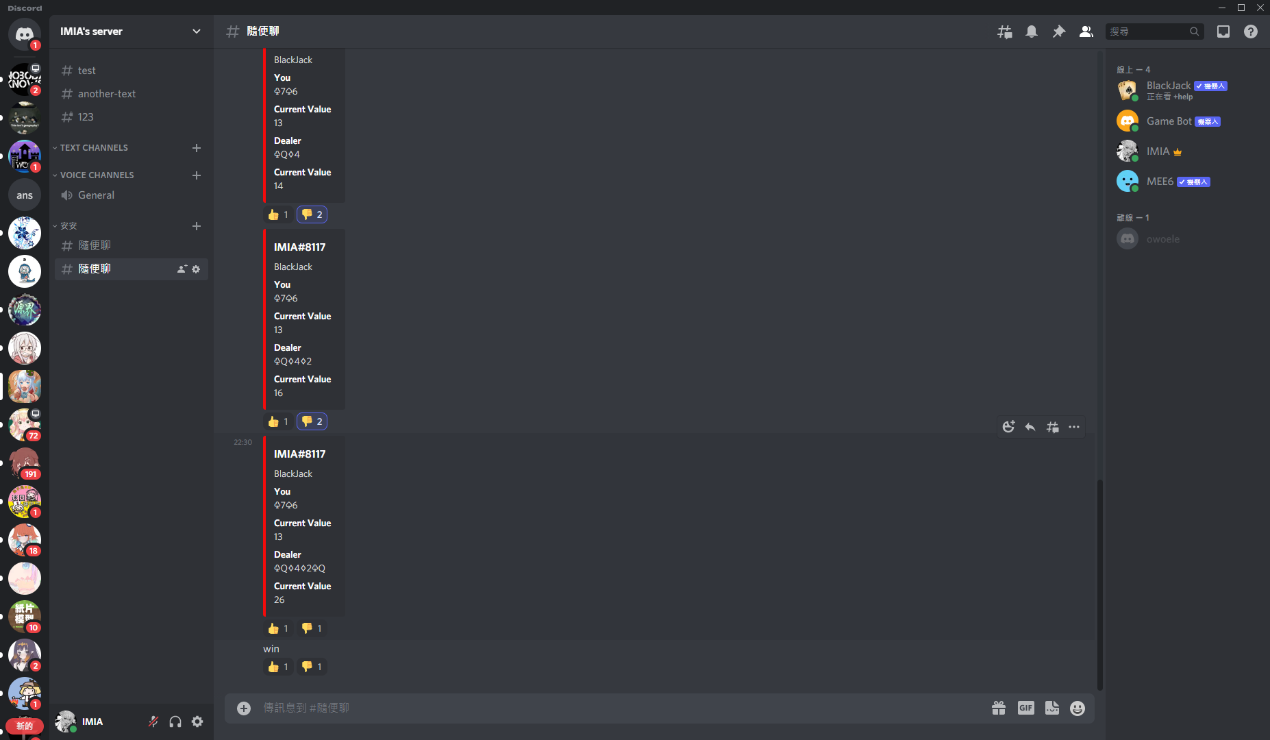
Dealer burst; bot send ‘Win’ in channel.

